Slide 1
Deep Learning
Recurrent Neural Networks

Slide 2
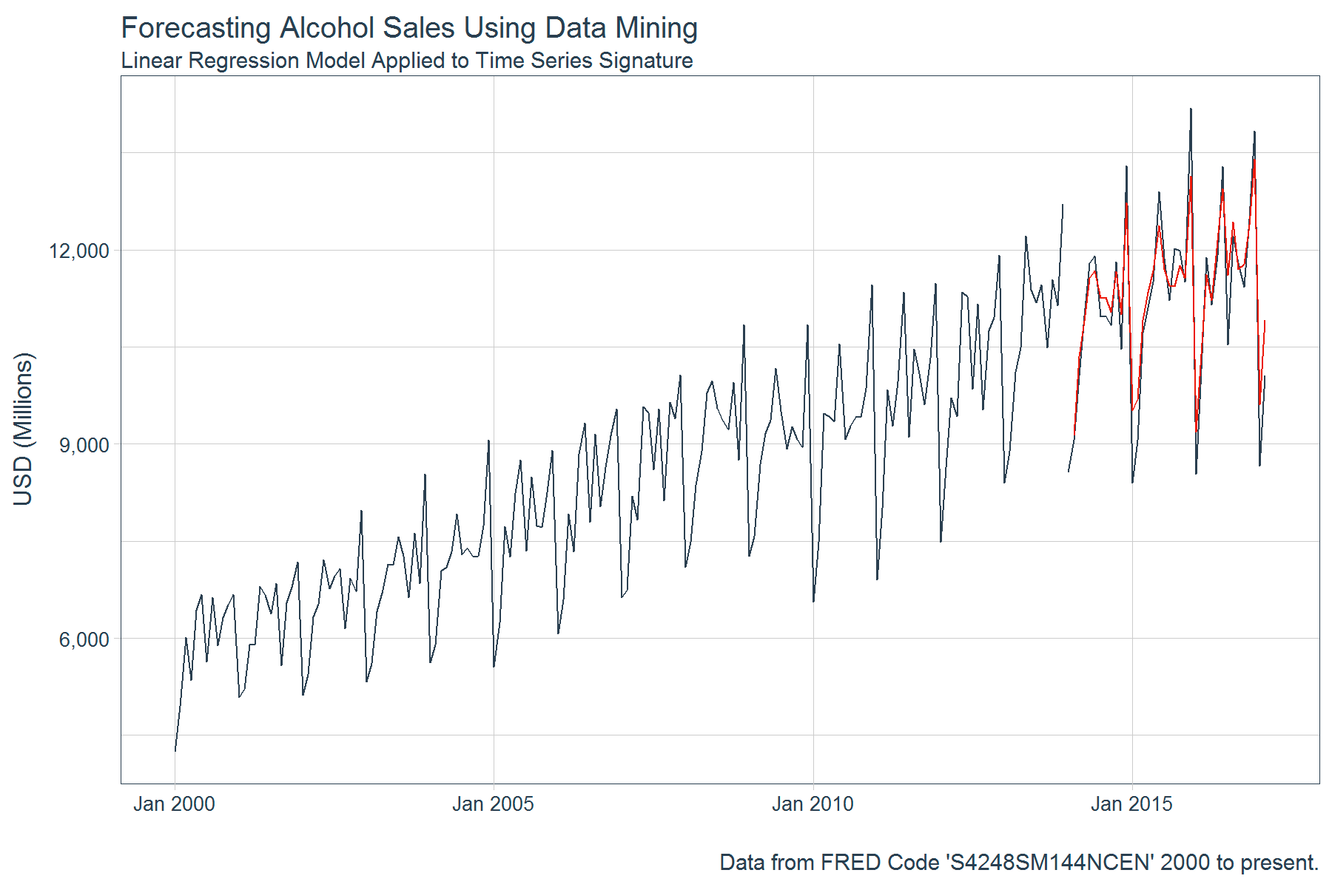

Time Series & Sequential Data
Real valued time-series data
Sequential Categorial Data

Slide 3
Language Modelling as a Sequential Task
Mary ….
Mary had …
Mary had a little …
She went to the shops!
She went two the shops!
Language Modelling – building a model of a language that describes the statistical properties of the language such that we can for example:
Predict the next word
Decide how probable one sentence rather than another
Both Neural and non-neural solutions are available

Slide 4
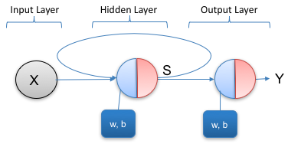
A Basic Recurrent Neural Network

Slide 5
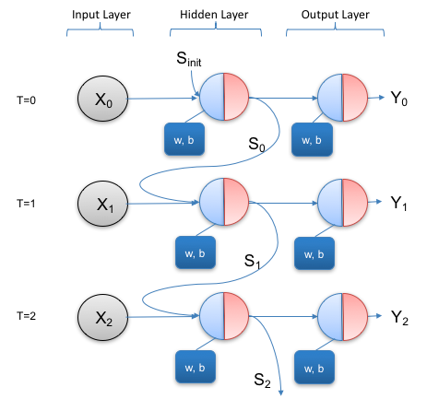
Unfolding the Simple Network over Time

Slide 6
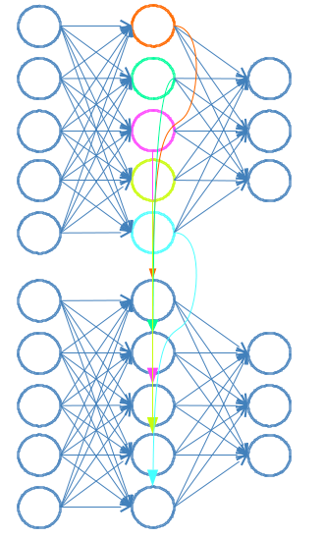
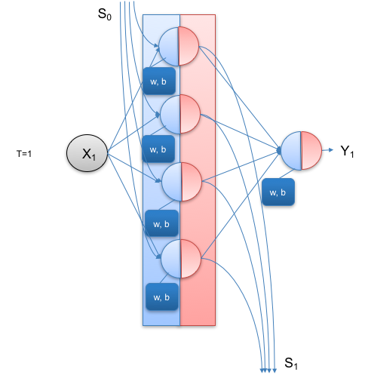
Recurrent Network with More Neurons
Timestep 1
Timestep 2

Slide 7
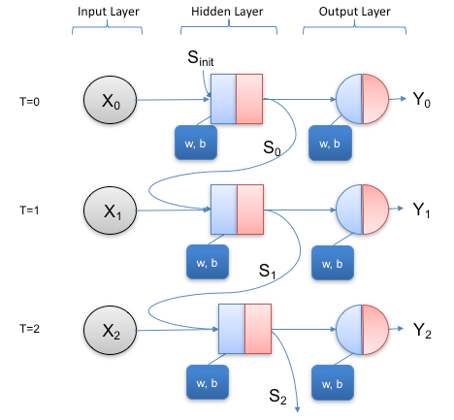
LSTM Layers Rather than Cells
We will come back to this in a couple of weeks

Slide 8
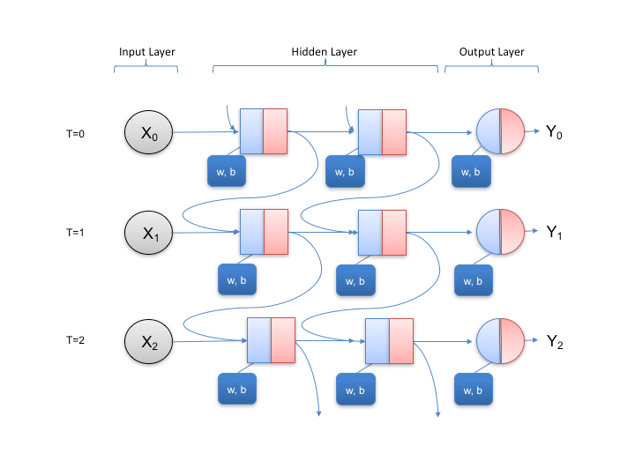
Multiple RNN Layers

Slide 9
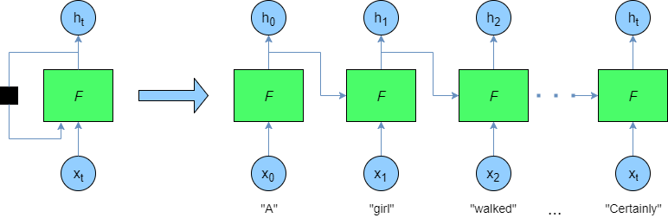
A Horizontal View on a Similar Model

Slide 10
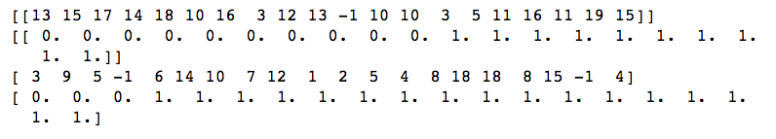
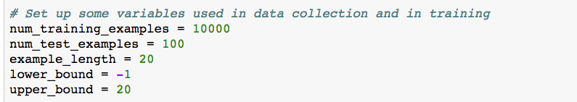
Example: Trip Alarm
Process through a string of numbers and produce either a 0 or 1 for each number. Produce 0s until a -1 is encountered in the input stream. Once a -1 is encountered, switch the output to 1 and always stay at 1.

Slide 11
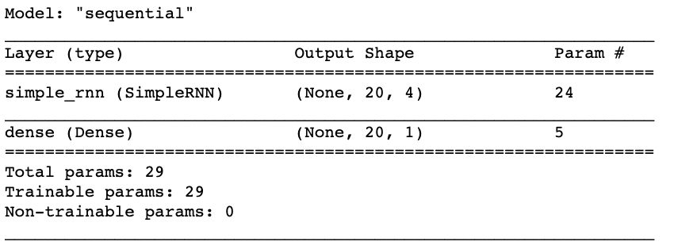
Network Design
Inputs: (Batch_size, 20, 1)

Slide 12
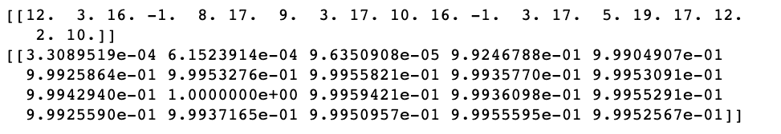
Example Output

Slide 13
Something Challenging: Language Modelling
Example: what is the next word?
He sat with the ring in his pocket, perspiring, anxious, waiting for the perfect moment that would never come. Finally he slid his hand from his pocket, and asked Marie if she would….
2021 - Note that we did not cover this in week 8 due to technical reasons. This will be covered in the first week after easter when we return to RNNs and specifically the LSTM

Slide 14

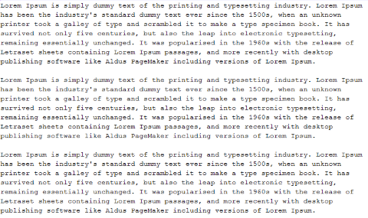
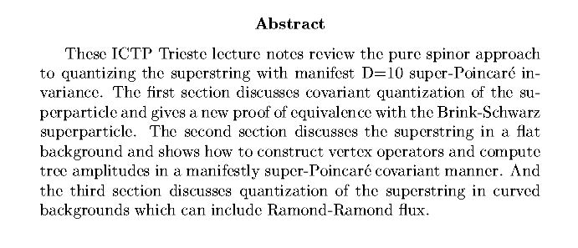
Language Modelling
Model
(Tables of Stats or Something Else)
Corpus of Input Text
Statistics on likelihood of sentences
Automatic Generation of New Content

Slide 15
Statistical Language Modelling
Analyse a training text corpus
Count how many words, pairs of words, triples of words etc are seen in the corpus
Build a model that predicts the most likely word given a sequence of words to date based on the maximum probabilities or likelihoods
Works well for small corpora
How it works in detail is beyond our scope, but worth looking at usage

Slide 16
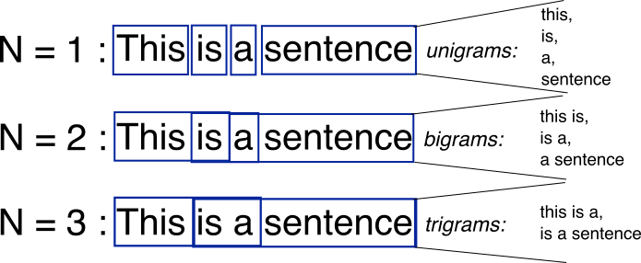
N-Grams
Chunkings of sentences that are of a certain length (N)
https://stackoverflow.com/questions/18193253/what-exactly-is-an-n-gram

Slide 17
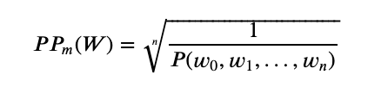

Language Modelling Metric: Perplexity
A measure of how surprised our model is by our test input data
A normalised inverse of probability
Also related to Cross Entropy
Allows us to calculate Perplexity even without explicit Probability model
where H(W) is the cross entropy result for test data

Slide 18
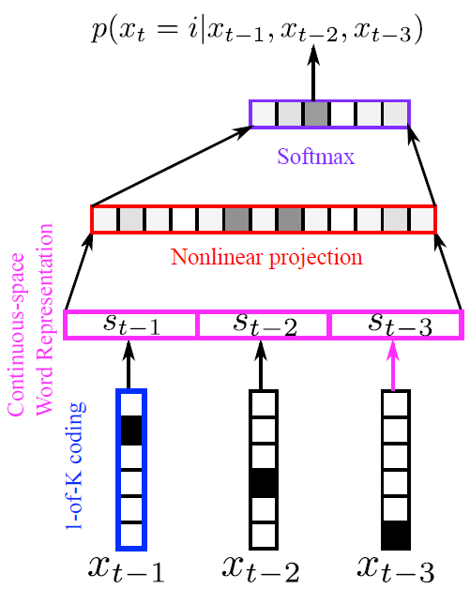
A Naïve View of a Neural Language Model
Our goal: predict the most likely next word!

Slide 19
Recurrent Neural Network for Language Modelling

Slide 20
Let’s make it easier - character based!

Slide 21
Look at code…

